Slide 1

NalamAI
Shanmuga Priya L -111725201143
Saranyaa D - 111725201136
Sakthi Priya S - 111725201124

Slide 2



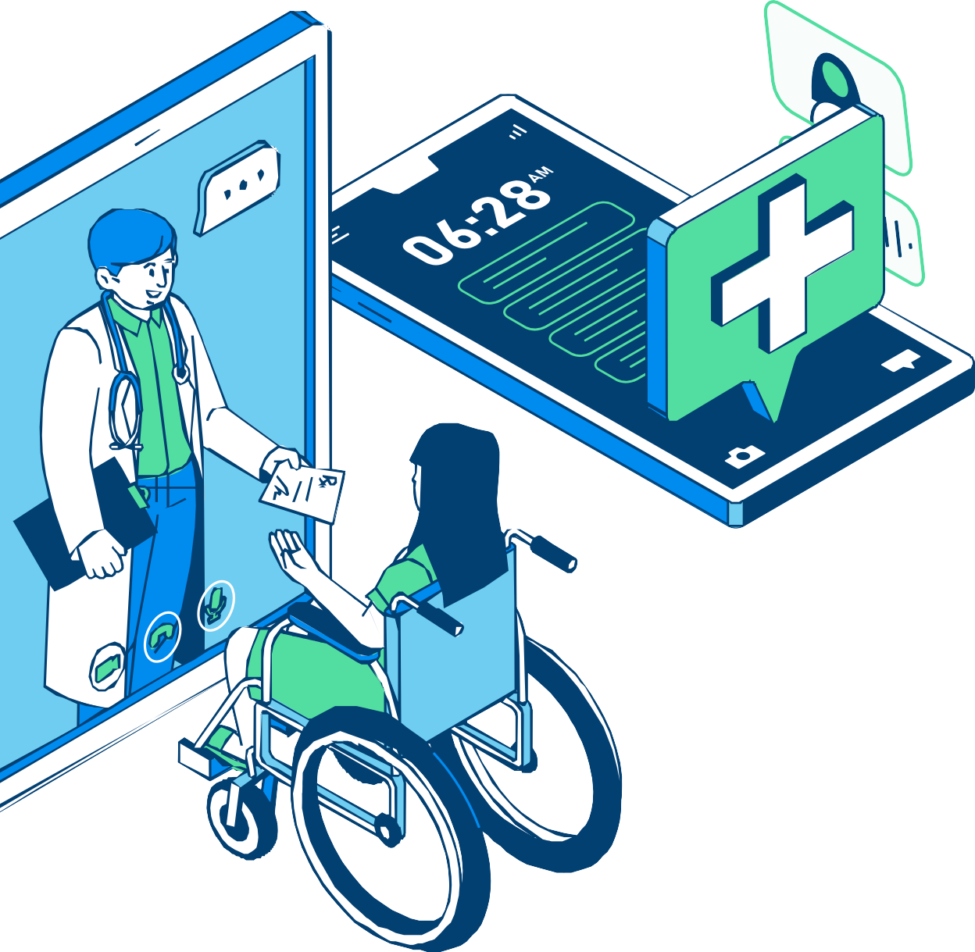
NalamAI is an AI-powered smart healthcare assistant designed to improve access to healthcare services for people in rural and underserved communities. The system addresses common challenges such as limited access to doctors, difficulty in identifying health problems at an early stage, medication management, emergency situations, and lack of organized medical records. NalamAI provides multiple integrated features including an AI-based voice symptom checker, telemedicine support, medicine reminders, emergency SOS, caregiver notifications, and digital health records. Users can describe their symptoms through voice, including regional languages, and receive preliminary health guidance before consulting a healthcare professional.
The platform also enables users to connect with doctors remotely, receive medication reminders, and securely maintain their medical information. In emergency situations, the SOS feature can notify predefined contacts and share the user's location. By combining Artificial Intelligence, voice technology, telemedicine, and mobile healthcare, NalamAI aims to make healthcare more accessible, affordable, and convenient for rural and underserved populations. The proposed system can be further enhanced with wearable health monitoring, offline functionality, and personalized AI assistance.
Abstract

Slide 3
Motivation and Vision
🏥 Healthcare accessibility is still a major challenge in rural and underserved communities.
🔍 We studied existing healthcare solutions.
🤖 AI chatbots, telemedicine, medicine reminders, and remote monitoring are mostly separate solutions.
🔗 We identified the need to integrate these services into one platform.
💡 So, we proposed NalamAI as an integrated healthcare assistant.
👥 It aims to make healthcare simple, accessible, affordable, and user-friendly.

Slide 4
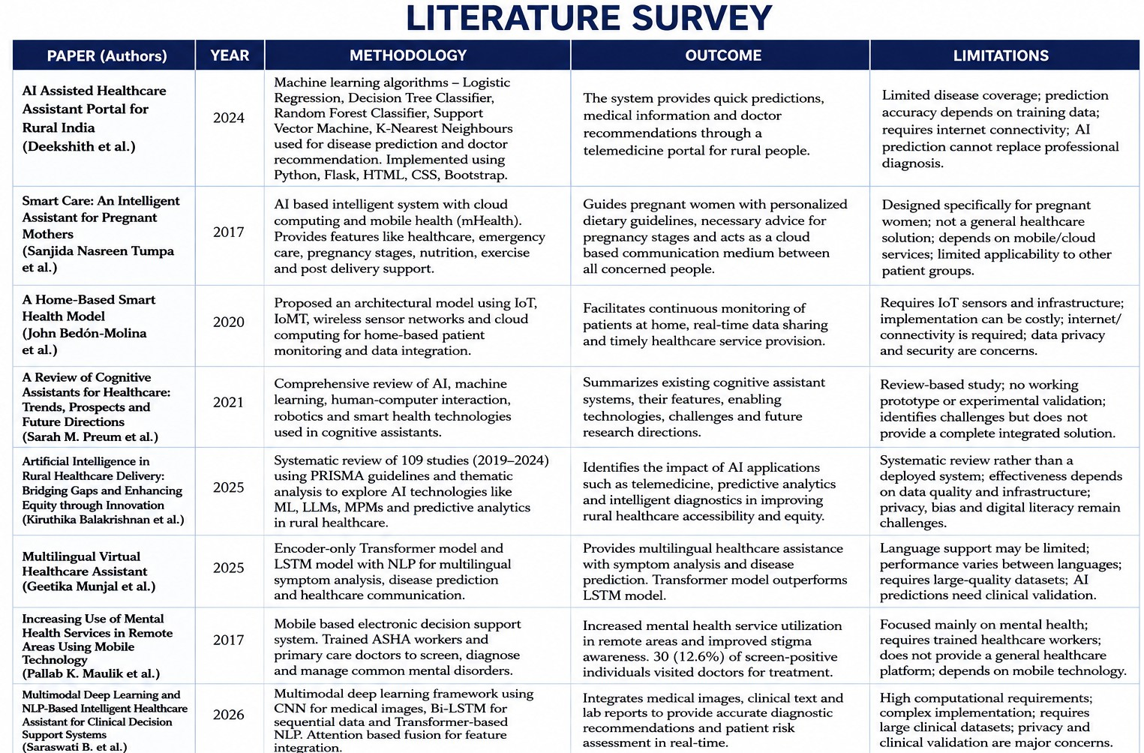

Slide 5

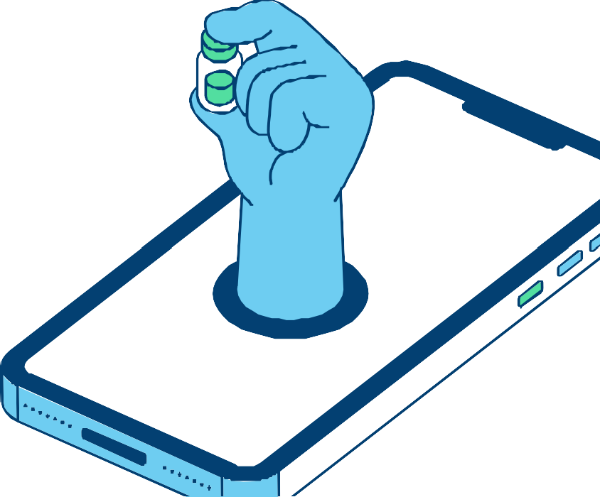

Existing systems focus on individual healthcare problems. Services are mostly separate solutions.
Lack of a single integrated AI platform.
Limited focus on rural & underserved communities. Proposed solution: Integrated healthcare assistant. Includes Symptom Analysis, Voice Support, Telemedicine, Medicine Reminder, SOS & Caregiver Support.
EXISTING

Slide 6
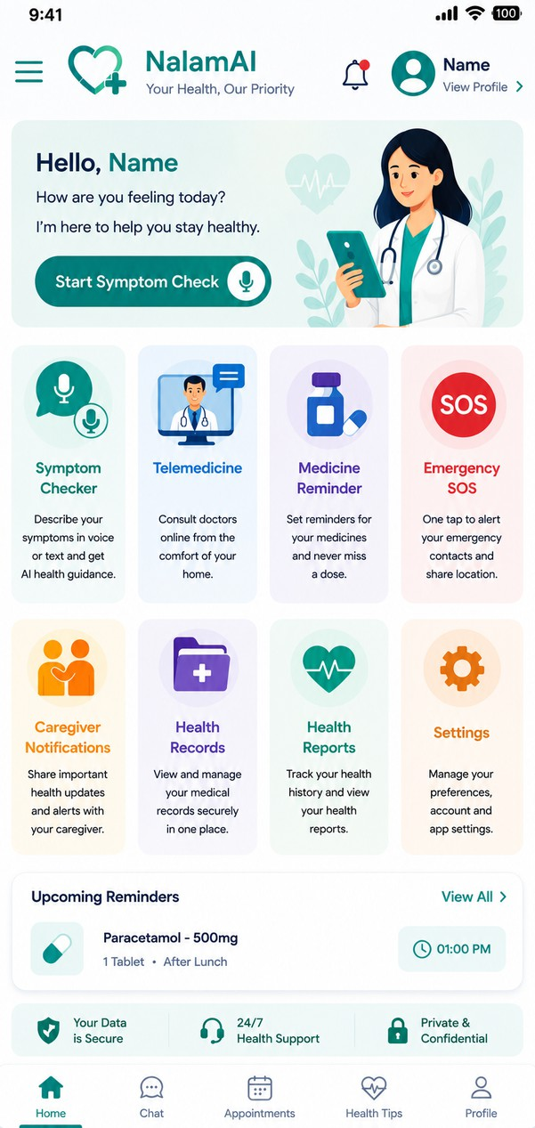
PROPOSED
Our proposed system is an integrated AI-powered healthcare assistant that provides an AI voice symptom checker to analyse user-reported symptoms and predict possible health conditions with basic health guidance, along with Tamil and English multilingual voice and text support to reduce language barriers for rural users. It also provides telemedicine/doctor consultation for remote access to healthcare professionals, a medicine reminder for tracking medication names, dosage and timings, an emergency SOS feature to alert registered emergency contacts, caregiver notifications for sharing important health updates and emergency alerts, and digital medical records to maintain the user’s symptoms, previous consultations, medicines and other health information for future reference.

Slide 7
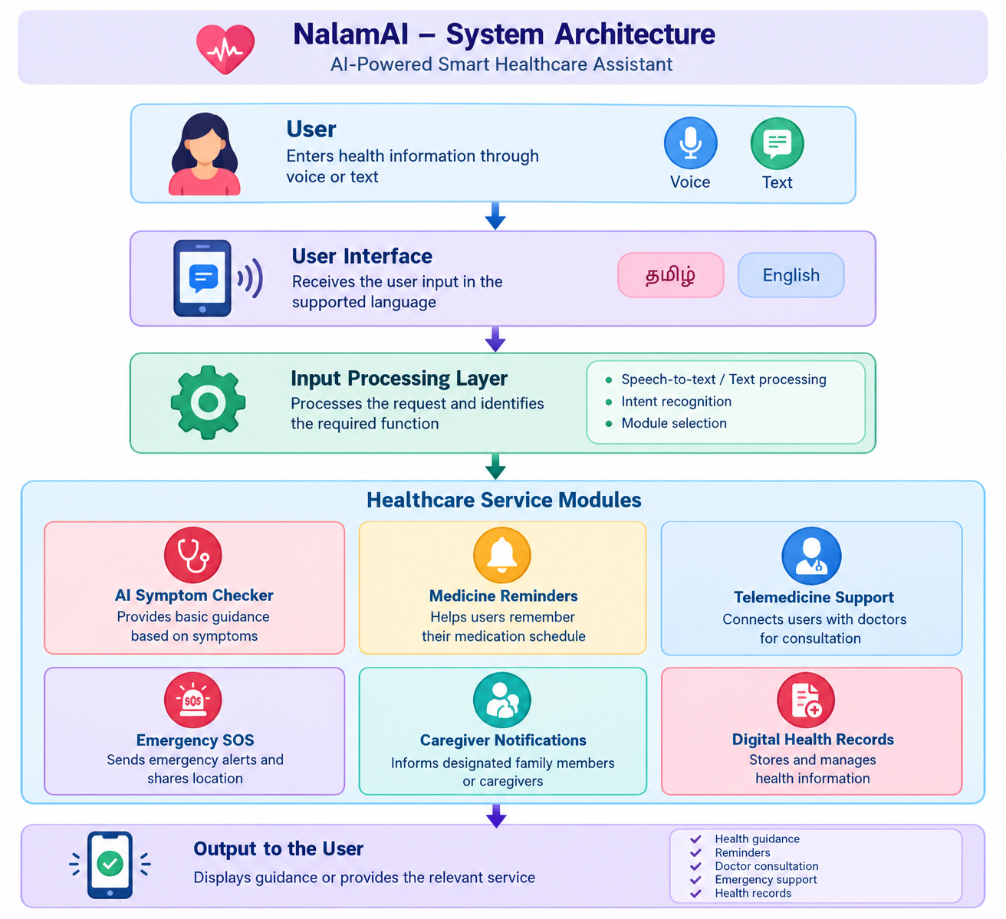

Slide 8
Module used:
Symptom Checker Module → analyses symptoms Medicine Reminder Module → reminds users to take medicines
Telemedicine Module → connects users with doctors SOS Module → handles emergencies
Medical Records Module → stores health information

Slide 9
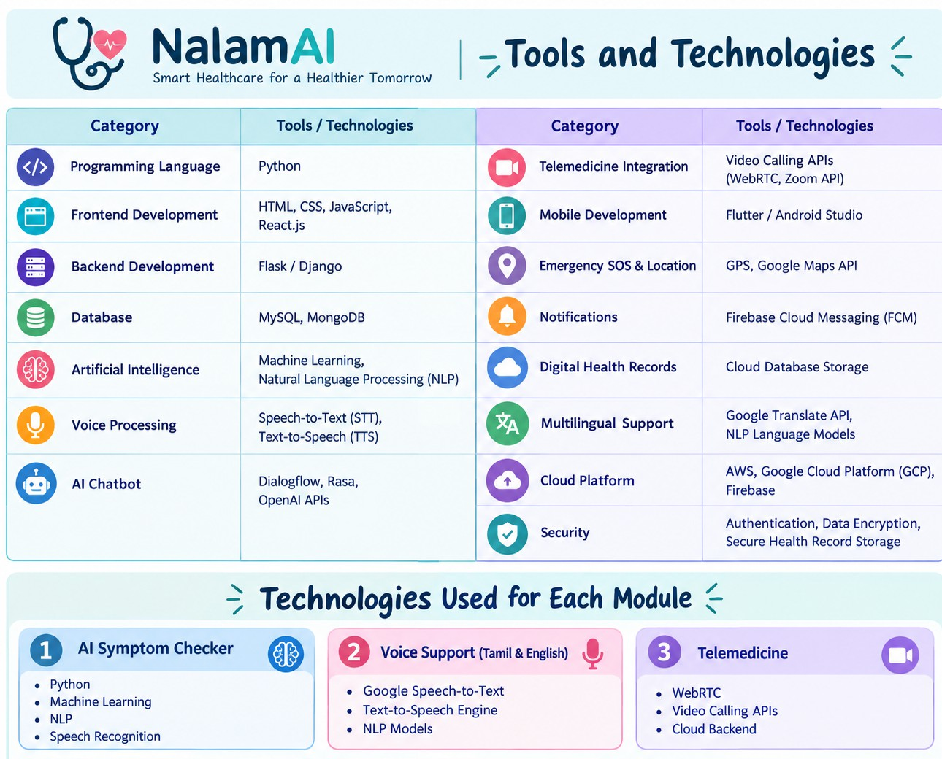

Slide 10
World Health Organization (WHO), Global Strategy on Digital Health 2020–2025. Geneva, Switzerland: WHO, 2021.
World Health Organization, Telemedicine: Opportunities and Developments in Member States. Geneva, Switzerland: WHO Press, 2010.
E. J. Topol, Deep Medicine: How Artificial Intelligence Can Make Healthcare Human Again. New York, NY, USA: Basic Books, 2019.
T. Davenport and R. Kalakota, “The Potential for Artificial Intelligence in Healthcare,” Future Healthcare Journal, vol. 6, no. 2, pp. 94–98, 2019. 1.
A. Esteva, A. Robicquet, B. Ramsundar, et al., “A Guide to Deep Learning in Healthcare,” Nature Medicine, vol. 25, no. 1, pp. 24–29, 2019.
E. B. Larson, “Building Trust in Artificial Intelligence for Healthcare,” The Lancet Digital Health, vol. 1, no. 2, pp. e67–e68, 2019.
M. M. Islam, M. Rahaman, and M. R. Islam, “Development of Smart Healthcare Monitoring System in IoT Environment,” SN Computer Science, vol. 1, no. 3, pp. 1–11, 2020.
R. K. Reddy and V. Kumar, “Artificial Intelligence in Healthcare: Opportunities and Challenges,” International Journal of Healthcare Information Systems and Informatics, vol. 15, no. 3, pp. 1–15, 2020.
J. G. Mantas and A. Hasman, Health Informatics: An Overview. Amsterdam, Netherlands: IOS Press, 2017.
A. K. Jha, D. Doolan, D. Grandt, T. Scott, and D. W. Bates, “The Use of Health Information Technology in Seven Nations,” International Journal of Medical Informatics, vol. 77, no. 12, pp. 848–854, 2008.
S. Shickel, P. J. Tighe, A. Bihorac, and P. Rashidi, “Deep EHR: A Survey of Recent Advances in Deep Learning Techniques for Electronic Health Record Analysis,” IEEE Journal of Biomedical and Health Informatics, vol. 22, no. 5, pp. 1589–1604, 2018.
D. W. Bates, S. Saria, L. Ohno-Machado, A. Shah, and G. Escobar, “Big Data in Health Care: Using Analytics to Identify and Manage High-Risk and High-Cost Patients,” Health Affairs, vol. 33, no. 7, pp. 1123–1131, 2014.
E. Ammenwerth and C. Iller, “IT-Adoption and the Interaction of Task, Technology and Individuals,” BMC Medical Informatics and Decision Making, vol. 6, no. 3, pp. 1–9, 2006.
D. Luxton, Artificial Intelligence in Behavioral and Mental Health Care. London, U.K.: Academic Press, 2016.
H. Yang, J. Yu, and X. Luo, “Artificial Intelligence Enabled Health Monitoring Systems,” IEEE Access, vol. 8, pp. 123456–123470, 2020.
A. Bohr and K. Memarzadeh, Artificial Intelligence in Healthcare. London, U.K.: Academic Press, 2020.
J. Hollis, C. Falconer, M. Martin, et al., “Annual Research Review: Digital Health Interventions for Children and Young People,” Journal of Child Psychology and Psychiatry, vol. 58, no. 4, pp. 474–503, 2017.
S. Patel, H. Park, P. Bonato, L. Chan, and M. Rodgers, “A Review of Wearable Sensors and Systems with Application in Rehabilitation,” Journal of NeuroEngineering and Rehabilitation, vol. 9, no. 21, pp. 1–17, 2012.
P. Groves, B. Kayyali, D. Knott, and S. Van Kuiken, The Big Data Revolution in Healthcare. McKinsey & Company, 2013.
A. Sheikh, K. Sood, and S. Bates, “Leveraging Health Information Technology to Achieve the Triple Aim of Healthcare Reform,” Journal of the American Medical Informatics Association, vol. 22, no. 4, pp. 849–856, 2015.
J. Jiang, B. Guo, Y. Li, and J. Chen, “The Future of Healthcare with Artificial Intelligence,” Healthcare Technology Letters, vol. 4, no. 5, pp. 1–10, 2018.
S. Ryu, “Telemedicine: Opportunities and Developments in Member States,” Healthcare Informatics Research, vol. 18, no. 2, pp. 153–155, 2012.
R. Agarwal, G. Gao, C. DesRoches, and A. K. Jha, “Research Commentary—The Digital Transformation of Healthcare,” Information Systems Research, vol. 21, no. 4, pp. 796–809, 2010.
P. T. Cortez and M. Morais, “Electronic Health Records and Their Impact on Healthcare Quality,” International Journal of Medical Informatics, vol. 82, no. 5, pp. 321–330, 2013.
K. He, X. Zhang, S. Ren, and J. Sun, “Deep Residual Learning for Image Recognition,” in Proc. IEEE Conf. Computer Vision and Pattern Recognition (CVPR), Las Vegas, NV, USA, 2016, pp. 770–778.

Slide 11
